Slide 1
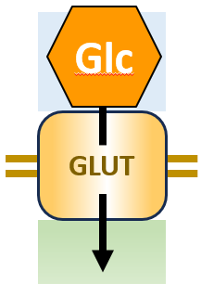
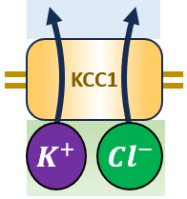
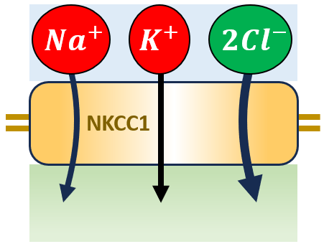
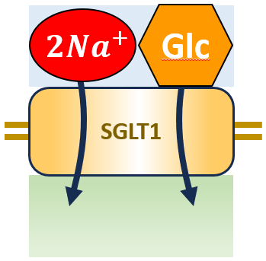
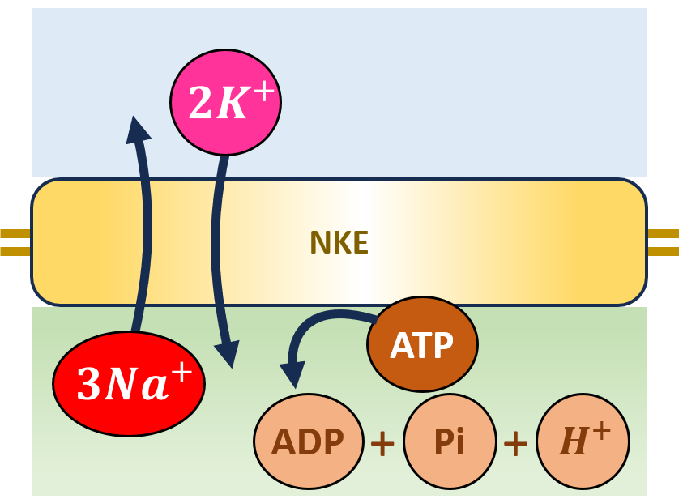
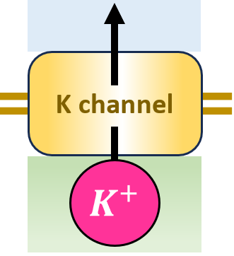
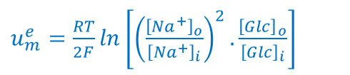
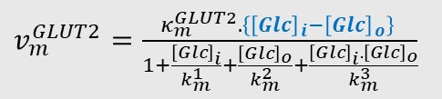
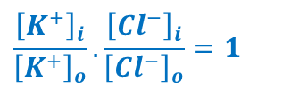
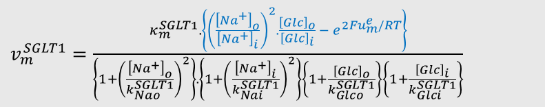
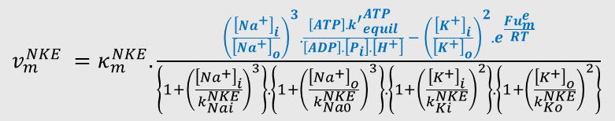

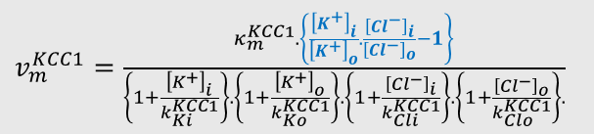



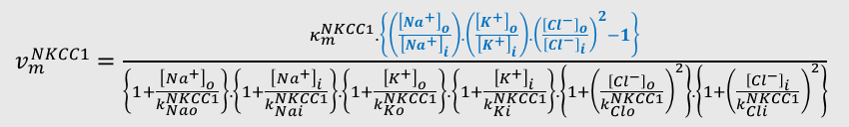

Alternative ways of achieving equilibrium
$v_{m}^{GLUT2}=\frac{κ_{m}^{GLUT2}.\left\{{\left[Glc\right]}_{i}−{\left[Glc\right]}_{o}\right\} }{1+\frac{{\left[Glc\right]}_{i}}{k_{m}^{1}}+\frac{{\left[Glc\right]}_{o}}{k_{m}^{2}}+\frac{{\left[Glc\right]}_{i}.{\left[Glc\right]}_{o}}{k_{m}^{3}}}$
$${\left[Glc\right]}_{i}={\left[Glc\right]}_{o}$$
Electroneutral
transporters
$v_{m}^{KCC1}=\frac{κ_{m}^{KCC1}. \left\{\frac{{\left[K^{+}\right]}_{i}}{{\left[K^{+}\right]}_{o}}.\frac{{\left[{Cl}^{−}\right]}_{i}}{{\left[{Cl}^{−}\right]}_{o}}−1\right\}}{\left\{1+\frac{{\left[K^{+}\right]}_{i}}{k_{Ki}^{KCC1}}\right\}.\left\{1+\frac{{\left[K^{+}\right]}_{o}}{k_{Ko}^{KCC1}}\right\}.\left\{1+\frac{{\left[{Cl}^{−}\right]}_{i}}{k_{Cli}^{KCC1}}\right\}.\left\{1+\frac{{\left[{Cl}^{−}\right]}_{o}}{k_{Clo}^{KCC1}}\right\}.}$
$$\frac{{\left[K^{+}\right]}_{i}}{{\left[K^{+}\right]}_{o}}.\frac{{\left[{Cl}^{−}\right]}_{i}}{{\left[{Cl}^{−}\right]}_{o}}=1$$
$v_{m}^{NKCC1}=\frac{κ_{m}^{NKCC1}.\left\{\left(\frac{{\left[{Na}^{+}\right]}_{o}}{{\left[{Na}^{+}\right]}_{i}}\right).\left(\frac{{\left[K^{+}\right]}_{o}}{{\left[K^{+}\right]}_{i}}\right).{\left(\frac{{\left[{Cl}^{−}\right]}_{o}}{{\left[{Cl}^{−}\right]}_{i}}\right)}^{2}−1\right\}}{\left\{1+\frac{{\left[{Na}^{+}\right]}_{o}}{k_{Nao}^{NKCC1}}\right\}.\left\{1+\frac{{\left[{Na}^{+}\right]}_{i}}{k_{Nai}^{NKCC1}}\right\}.\left\{1+\frac{{\left[K^{+}\right]}_{o}}{k_{Ko}^{NKCC1}}\right\}.\left\{1+\frac{{\left[K^{+}\right]}_{i}}{k_{Ki}^{NKCC1}}\right\}.\left\{1+{\left(\frac{{\left[{Cl}^{−}\right]}_{o}}{k_{Clo}^{NKCC1}}\right)}^{2}\right\}.\left\{1+{\left(\frac{{\left[{Cl}^{−}\right]}_{i}}{k_{Cli}^{NKCC1}}\right)}^{2}\right\}}$
$\left(\frac{{\left[{Na}^{+}\right]}_{o}}{{\left[{Na}^{+}\right]}_{i}}\right).\left(\frac{{\left[K^{+}\right]}_{o}}{{\left[K^{+}\right]}_{i}}\right).{\left(\frac{{\left[{Cl}^{−}\right]}_{o}}{{\left[{Cl}^{−}\right]}_{i}}\right)}^{2}=1$
Electrogenic
transporters
$v_{m}^{SGLT1}=\frac{κ_{m}^{SGLT1}.\left\{{\left(\frac{{\left[{Na}^{+}\right]}_{o}}{{\left[{Na}^{+}\right]}_{i}}\right)}^{2}.\frac{{\left[Glc\right]}_{o}}{{\left[Glc\right]}_{i}} − e^{2Fu_{m}^{e}/RT}\right\}}{\left\{1+{\left(\frac{{\left[{Na}^{+}\right]}_{o}}{k_{Nao}^{SGLT1}}\right)}^{2}\right\}.\left\{1+{\left(\frac{{\left[{Na}^{+}\right]}_{i}}{k_{Nai}^{SGLT1}}\right)}^{2}\right\}\left\{1+\frac{{\left[Glc\right]}_{o}}{k_{Glco}^{SGLT1}}\right\}\left\{1+\frac{{\left[Glc\right]}_{i}}{k_{Glci}^{SGLT1}}\right\}}$
$u_{m}^{e}=\frac{RT}{2F}ln\left[{\left(\frac{{\left[{Na}^{+}\right]}_{o}}{{\left[{Na}^{+}\right]}_{i}}\right)}^{2}.\frac{{\left[Glc\right]}_{o}}{{\left[Glc\right]}_{i}}\right]$
Electrogenic
pumps
$v_{m}^{NKE} =κ_{m}^{NKE}.\frac{{\left(\frac{{\left[{Na}^{+}\right]}_{i}}{{\left[{Na}^{+}\right]}_{o}}\right)}^{3}.\frac{\left[ATP\right].{k^{′}}_{equil}^{ATP}}{\left[ADP\right].\left[P_{i}\right].\left[H^{+}\right]} − {\left(\frac{{\left[K^{+}\right]}_{i}}{{\left[K^{+}\right]}_{o}}\right)}^{2}.e^{\frac{Fu_{m}^{e}}{RT}}}{\left\{1+{\left(\frac{{\left[{Na}^{+}\right]}_{i}}{k_{Nai}^{NKE}}\right)}^{3}\right\}.\left\{1+{\left(\frac{{\left[{Na}^{+}\right]}_{o}}{k_{Na0}^{NKE}}\right)}^{3}\right\}.\left\{1+{\left(\frac{{\left[K^{+}\right]}_{i}}{k_{Ki}^{NKE}}\right)}^{2}\right\}.\left\{1+{\left(\frac{{\left[K^{+}\right]}_{o}}{k_{Ko}^{NKE}}\right)}^{2}\right\}}$
$u_{m}^{e}=\frac{RT}{F}ln\left[{\left(\frac{{\left[{Na}^{+}\right]}_{i}}{{\left[{Na}^{+}\right]}_{o}}\right)}^{3}{\left(\frac{{\left[K^{+}\right]}_{o}}{{\left[K^{+}\right]}_{i}}\right)}^{2}.\frac{\left[ATP\right].{k^{′}}_{equil}^{ATP}}{\left[ADP\right].\left[P_{i}\right].\left[H^{+}\right]}\right]$
Ion
channels
$v_{m}^{K}=κ_{m}^{K}\left({\left[K^{+}\right]}_{i}.e^{\frac{Fu_{m}^{e}}{RT}}−{\left[K^{+}\right]}_{o}\right). \frac{u_{m}^{e}}{e^{Fu_{m}^{e}/RT}−1}$
$$u_{m}^{e}=\frac{RT}{F}ln\left(\frac{{\left[K^{+}\right]}_{o}}{{\left[K^{+}\right]}_{i}}\right)$$

Slide 2

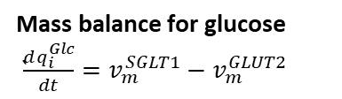














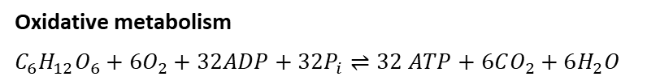
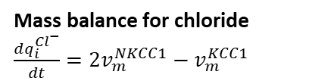


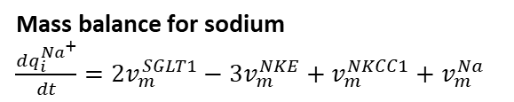









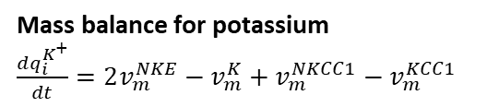




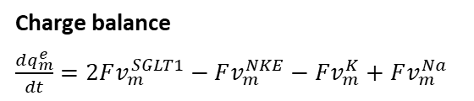



Epithelial cell
$$q_{b}^{{Na}^{+}}$$
$$q_{b}^{{Cl}^{−}}$$
$$q_{b}^{H_{2}O}$$
$$q_{b}^{O_{2}}$$
$$q_{b}^{Glc}$$
$$q_{b}^{{CO}_{2}}$$
$$q_{b}^{K^{+}}$$
Na⁺ K⁺ Cl⁻
Ouabain
3
2
2
$$v_{epi}^{H_{2}O}$$
Basolateral membrane
$$v_{m}^{NKE}$$
$$q_{m}^{e}$$
$$v_{m}^{K}$$
$$v_{m}^{GLUT2}$$
$$v_{m}^{Na}$$
$$v_{m}^{NKCC1}$$
$$v_{m}^{KCC1}$$
32
3
2
2
6
$$v_{i}^{AM}$$
$$q_{i}^{ATP}$$
$$F$$
$$F$$
$$F$$
1
$$q_{i}^{Glc}$$
6
32
$$q_{i}^{ADP}$$
$$q_{i}^{H_{2}O}$$
6
32
$$q_{i}^{K^{+}}$$
$$q_{i}^{P_{i}}$$
$$q_{i}^{{Na}^{+}}$$
$$q_{b}^{{Cl}^{−}}$$
$$2F$$
2
GLP-1
$$v_{duct}^{H_{2}O}$$
Epithelial cell
$$v_{`m}^{SGLT1}$$
Apical membrane
2
$$q_{duct}^{H_{2}O}$$
$$q_{duct}^{{Na}^{+}}$$
$$q_{duct}^{Glc}$$
Mass balance for glucose
`$\frac{dq_{i}^{Glc}}{dt}=v_{m}^{SGLT1}−v_{m}^{GLUT2}$
Mass balance for potassium
$\frac{dq_{i}^{K^{+}}}{dt}=2v_{m}^{NKE}−v_{m}^{K}+v_{m}^{NKCC1}−v_{m}^{KCC1}$
Charge balance
$\frac{dq_{m}^{e}}{dt}=2Fv_{m}^{SGLT1}−Fv_{m}^{NKE}−Fv_{m}^{K}+Fv_{m}^{Na}$
Mass balance for sodium
$\frac{dq_{i}^{{Na}^{+}}}{dt}=2v_{m}^{SGLT1}−3v_{m}^{NKE}+v_{m}^{NKCC1}+v_{m}^{Na}$
Mass balance for chloride
$\frac{dq_{i}^{{Cl}^{−}}}{dt}=2v_{m}^{NKCC1}−v_{m}^{KCC1}$
Oxidative metabolism
$C_{6}H_{12}O_{6}+6O_{2}+32ADP+32P_{i}⇌32 ATP+6CO_{2}+6H_{2}O$

Slide 3
Like endothelium, epithelial cells are contractile via their peri-junctional actomyosin ring. Inflammatory mediators:

